Slide 1


Dr. D. Y. Patil Institute Of Engineering, Management & Research - [DYPIEMR] Akurdi, Pune
PBL Topics
Presented by :-
1)Nirmal
2)Sanjay
3)Kaustubh
4)Yash
5)Pratik

Slide 2
Content
1. Definition
2.Machine Learning in Stock Price Prediction
3.Machine Learning Sentimental Analysis
4.Web Chat

Slide 3
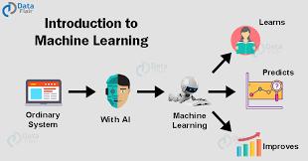
Introduction Machine learning
It is a branch of artificial intelligence, concerns the construction and study of systems that can learn from data.

Slide 4

Machine Learning in Stock Marketing
The field of Machine Learning is vast and plays a key role in
a wide range of critical applications.
The concept of Support Vector Machines (SVM)
have advanced features that are reflected in their
good generalization capacity and fast computation.
The concept of LSTM(Long-Short Term Memory)
use to solve long and short period problem of stock markets
Predicting the stock market involves predicting
the closing prices of a company’s stock for any
given number of days ahead.

Slide 5
Architecture
Data Flow Diagram
Input: Company
Fetch Data
Plot Data
Train Model
Save Model
Plot Predicted Result
Predict Stock For n days

Slide 6
Sentimental Analysis

Slide 7
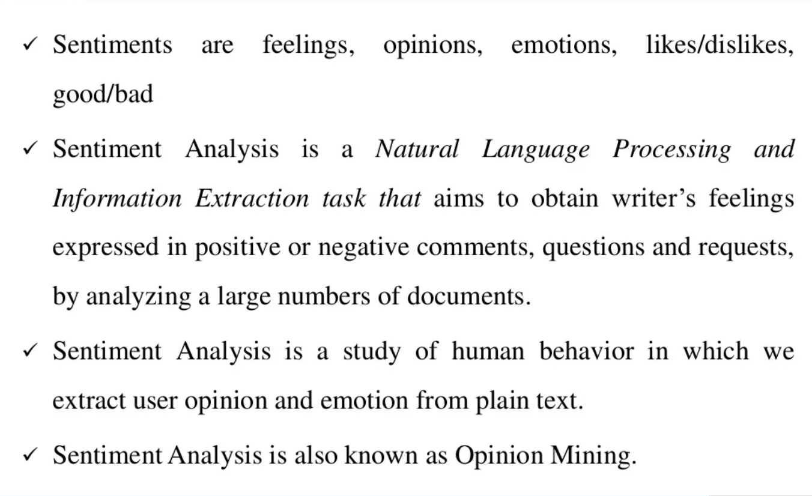
What is Sentimental Analysis ?

Slide 8
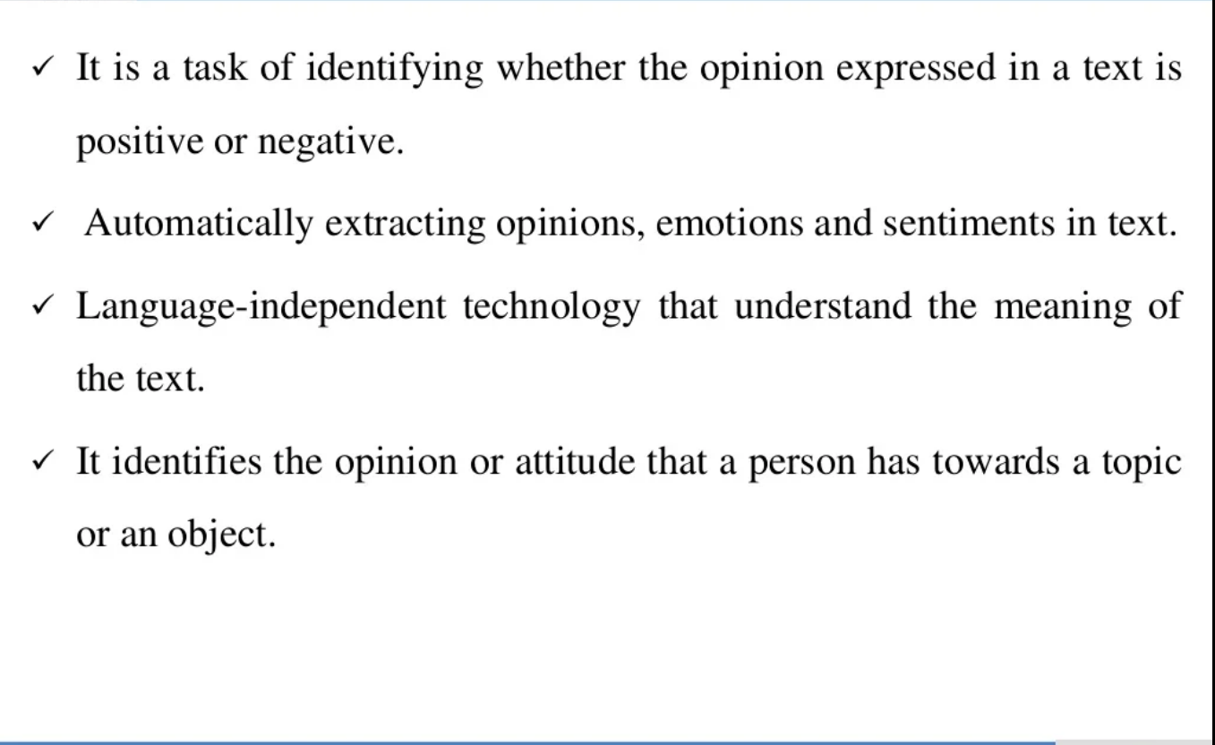
What is the use of Sentimental Analysis ?

Slide 9
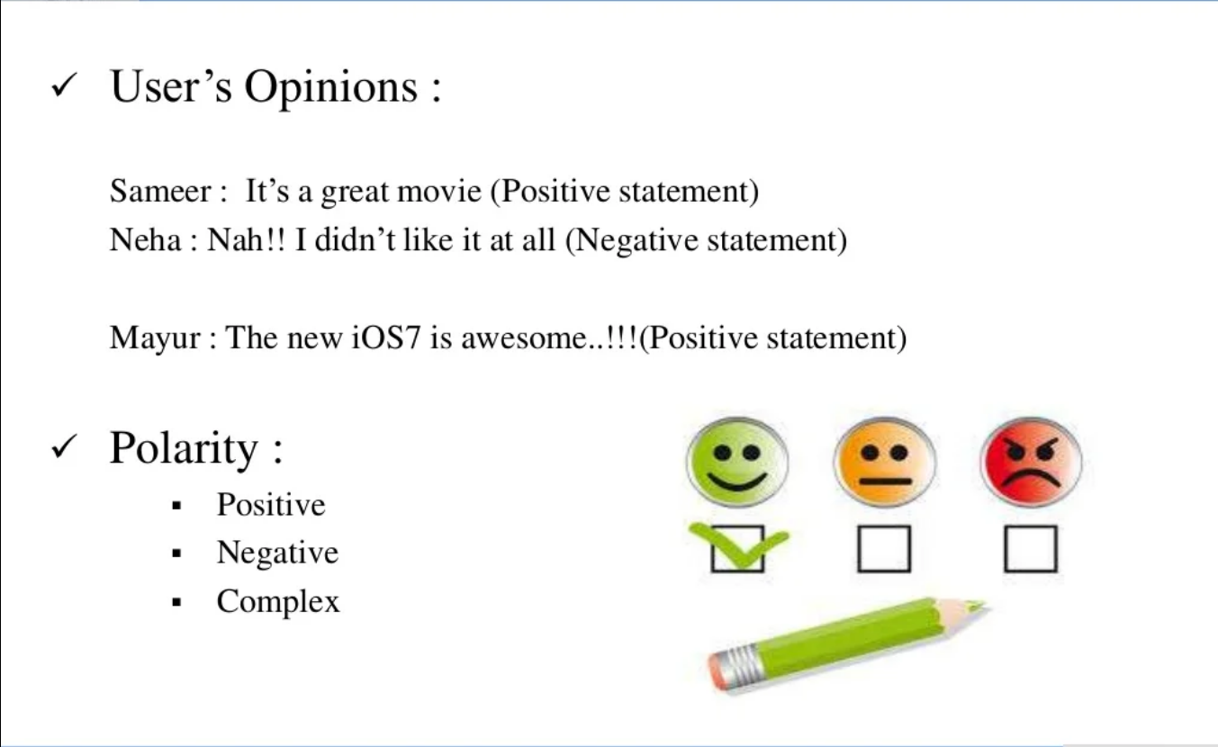
Example of Sentimental Analysis ?

Slide 10

Web Chat

Slide 11


Chat and Chat Application
Chat application :-
Online chat in a less stringent definition may be primarily any direct text-based or video-based (Webcams),one-on –one chat or one-to-many group chat (formerly also known as synchronous conferencing) ,using tools such as instant messengers ,Internet Relay Chat (IRC),talkers and possibly MUD’s
Chat :-
Online chat may refers to any kind of communication
over the internet that offers a real time transmission of text messages from sender to receiver.
Online chat may address point to point communications from one sender to many receivers and voice and video chat ,or may be a feature of a web conferencing service.

Slide 12
Corporate Messenger App
Corporate messenger is a graphical chatting application that makes chatting a pleasant experience . It has excellent features that make any user do what ever he wants while chatting.

Slide 13

SYSTEM ANALYSIS
Proposed System:
The first step of analysis process involves the identification of need . The success of a system depends largely on how accurately a problem is defined , Thoroughly investigated and satisfying the customer needs by providing user friendly environment.
This system has been developed in order to overcome the difficulties encountered while using the mailing system for communication between the Users . Providing user friendly communication channel , live communication facility , categorizing the users, logging the communication transaction , sending public & private messages , sending instant& offline messages , graphical Communication are motivating factors for the development of this system.
Existing System :
The existing communication system is not built as a software application.
Everybody communicates with others physically or through the mails . Each and every user or employee of an organization has to register, get into his inbox and check for his mail which doesn’t provide live communication resemblance to the user. If this channel grows up to some extent it will be harder to place some restrictions on the users.

